Slide 1
Keim et al. (2010): Mastering the Information Age - Solving Problems with Visual Analytics
-Siddhesh Pawar, Divya Khairnar

Slide 2
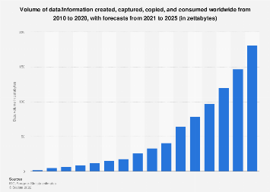
Introduction
Amount of data being generated is increasing day by day.
Processing and making sense out of this huge amount of data is an issue.
Information overload results in waste of time, money and opportunities.
Goal of Visual Analytics is to turn information overload into an opportunity by making data and information processing transparent.
VA combines the strengths of human and electronic data processing and is interdisciplinary.
Overarching goal is to create effective methods to exploit and use the information in unexplored and data sources.
Ref: [1] “Statista “ Statista.com. https://www.statista.com/statistics/871513/worldwide-data-created/ (accessed Feb 6,2023)
Fig 1: Increase in amount of data [1]

Slide 3

Introduction - 2
Transition from confirmatory data analysis to exploratory data analysis gave rise to the area of visual analytics.
Information visualization community was established due to the advancement of graphical user interfaces and interaction tools.
Visual data exploration and visual data mining were later developed.
VA combines disciplines including data analysis, spatial decision support, and visualization.

Slide 4
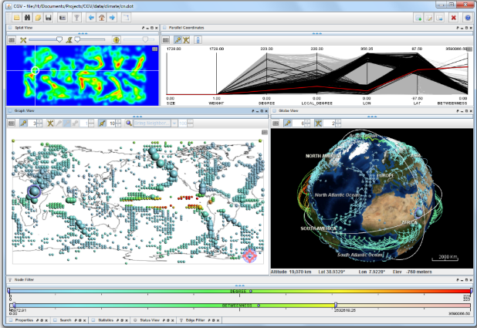
Visual Analytics
Visual analytics combines automated analysis techniques with interactive visualizations for better understanding.
Visual analytics enables people to synthesize information, detect both expected and unexpected results, provide timely understandable assessments, and communicate these assessments for action.
VA helps in dealing with massive data and generate knowledge from data and draws from multiple scientific disciplines.
Visual analytics is an important tool in several application areas where large amounts of information need to be processed and analyzed.
Visual analytics helps in analyzing massive amounts of unstructured data by identifying unexpected phenomena, detecting similarities and anomalies, and gaining useful knowledge
Ref: [2] D. A. Keim, J. Kohlhammer, et al. (Editors), Mastering the Information Age - Solving Problems with Visual Analytics, Eurographics, 2010.
Figure 2: Visual analytics used for weather monitoring

Slide 5
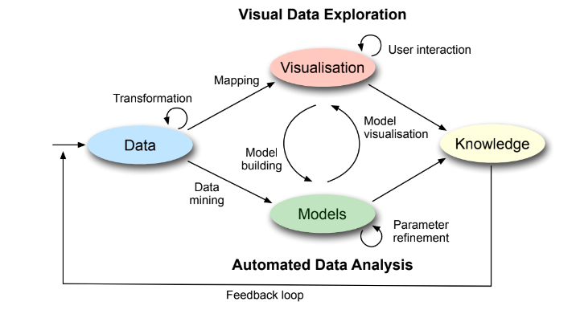
Visual Analytics Process
The visual analytics process is characterised through interaction between data, visualisations, models about the data, and the users in order to discover knowledge.
To efficiently use the data without missing intriguing patterns, the approach is driven by the maxim "Analyze first, show the important, zoom/filter, analyze further, details on demand.“
Ref: [3] ] D. A. Keim, J. Kohlhammer, et al. (Editors), Mastering the Information Age - Solving Problems with Visual Analytics, Eurographics, 2010.
Figure 3: VA Process[3]

Slide 6
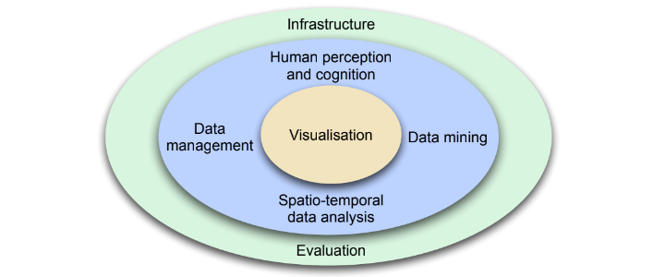
Building Blocks of Visual Analytics Research
Building blocks of Visual analytics are –
Visualization
Data Management
Data mining
Spatio-temporal Data Analysis
Perception and Cognition
Infrastructure
Evaluation
Ref: [4] ] D. A. Keim, J. Kohlhammer, et al. (Editors), Mastering the Information Age - Solving Problems with Visual Analytics, Eurographics, 2010.
Figure 4: Building Blocks [4]

Slide 7
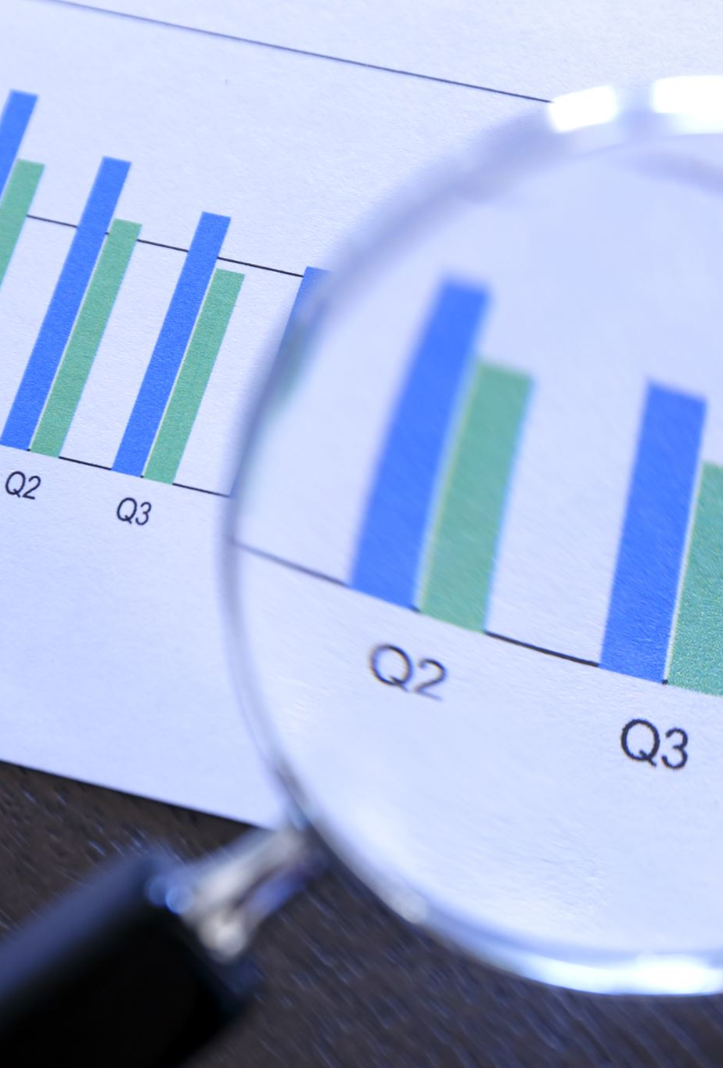
Data Management
Datasets are large and growing incrementally.
For managing data following issues need to be considered:
Heterogeneity of data sources – diverse data sources
Different data types – numeric, non-numeric, images, videos
Data streams – stocks, news
Working under pressure – fast data processing
Time consuming activities – dealing with null values

Slide 8
Gap in Visual Analytics and Data management
Dynamicity - Classical data management are not necessarily good for interaction.
Standards - While data management is based on standards, VA lacks in shared, proven, and efficient solution.
User interaction life-cycle - Data management interactions are single user and quick, while visual analytics activities are longer and may involve multiple users.

Slide 9
Research Fields in Data Management
Relational Technology - RDMS dominate the market
Data Integration - Providing unified and transparent access to a set of heterogeneous sources
Data Warehousing and Data Mining – Analyze information to make more informed decisions, and study patterns and trends in large dataset
Data Reduction and Abstraction – improve query optimization and interaction
Data Quality - Dealing with incomplete, inconsistent data

Slide 10
Data Management and Information Visualization
Visual Data Mining – combines traditional data mining tools with data visualization to enhance data mining
Visual OLAP(Online Analytics Platform) - support multi-dimensional data analysis and decision making by techniques such as graphs, charts.
Visual Data Reduction – represent information visually to reduce or eliminating irrelevant, redundant, or noisy data. (e.g.-clustering)
Visualization for the Masses - making data visualization and analysis accessible and usable to a wide range of users

Slide 11
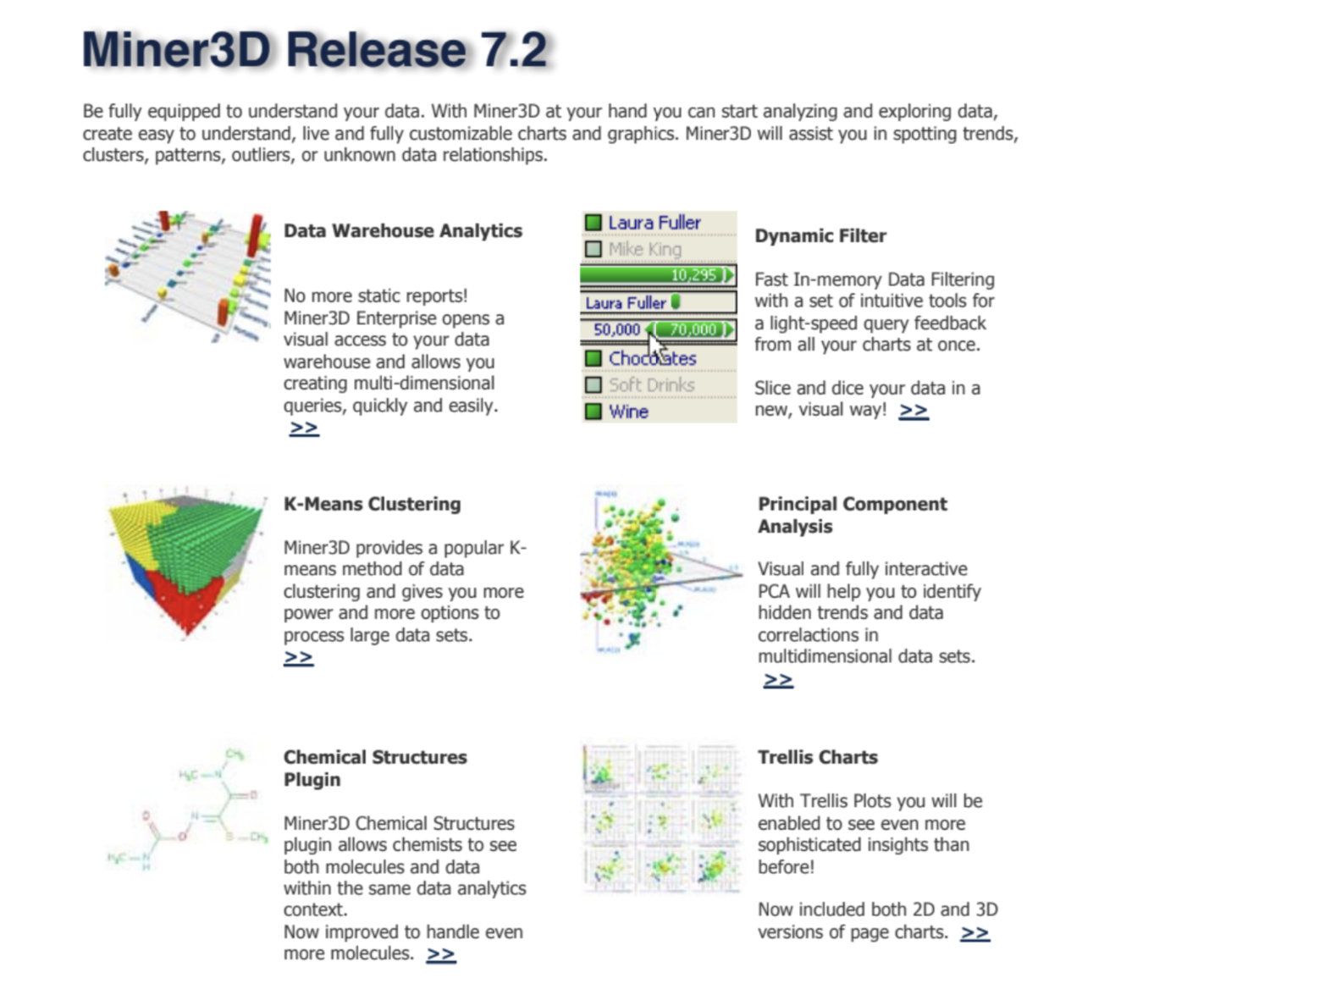
Data Management and Information Visualization
Fig 3: The commercial system Miner3D
Ref: [2] D. A. Keim, J. Kohlhammer, et al. (Editors), Mastering the Information Age - Solving Problems with Visual Analytics, Eurographics, 2010.

Slide 12
Grand Challenges faced by visual analytics
Analytical reasoning - reasoning frameworks for deriving insights and making decisions.
Visual representations - covers interactive techniques for visual representation of data.
Data representations and transformations – the ways of representing and transforming data, including dealing with noise, incompleteness, and uncertainty.
Production, presentation, and dissemination - refers to user interaction and activity.
Moving research into practice - the practical application of methods and techniques.

Slide 13

Knowledge discovery and data mining (KDD)
Extract useful and previously undiscovered insights from massive data sets.
Data cleaning, data integration, data selection, data transformation, data mining, pattern evaluation, and knowledge representation.
KDD often uses statistical models and machine learning techniques to find patterns and relationships in data.

Slide 14
Conclusion
The challenges and opportunities in data management and visual analytics are interrelated and require attention to basic data management problems and specific requirements for visual analytics.
Addressing these challenges, such as uncertainty, semantic integration, data provenance, and designing visual analytics for the general public, is crucial for making progress in the field of visual analytics.
Combining KDD and visual analytics can help generate efficient data visualization models.

Slide 15
THANK YOU!!

